Slide 1
What is Smith-Magenis Syndrome (SMS)?

Slide 2
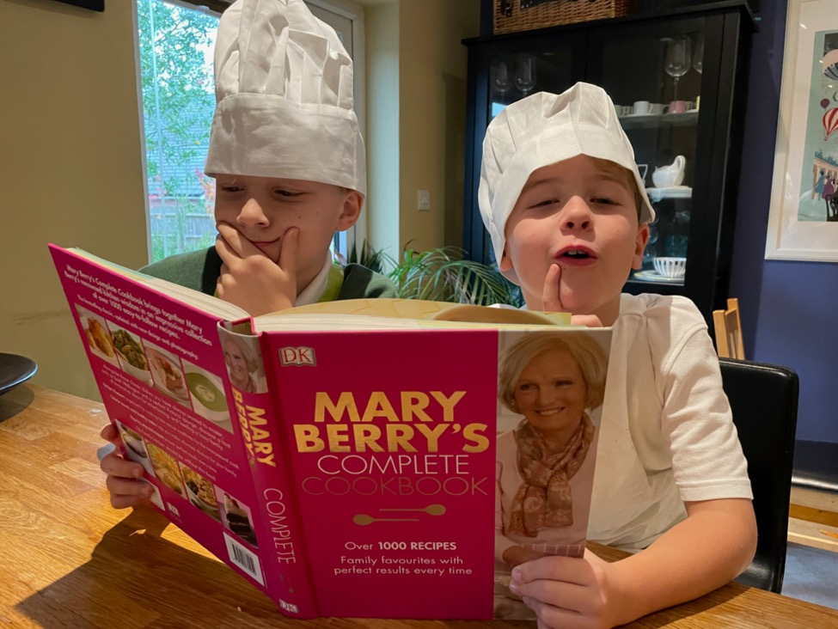
So, what are genes?
Genes are like recipes for our body.
Each gene is an instruction (like a recipe) that tells the body how to make us.

Slide 3
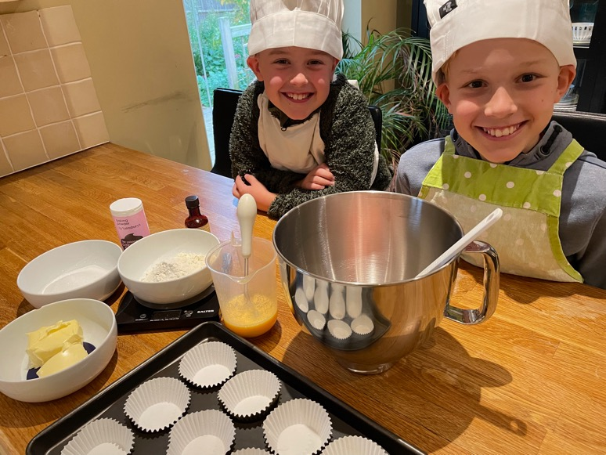
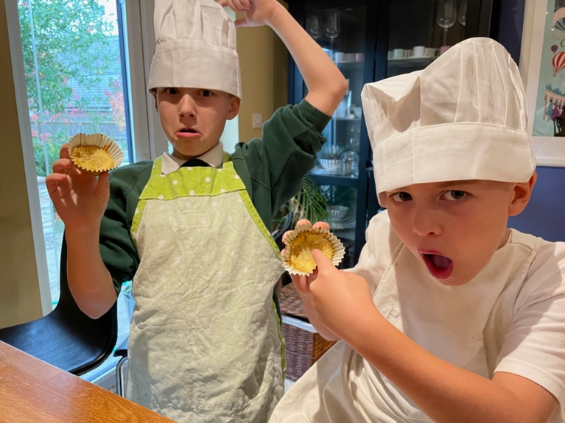
If we don’t follow a recipe, what might happen?

Slide 4
If we made a big mistake, like forgetting a key ingredient, this could result in a more serious problem.
A small mistake like forgetting chocolate chips might mean the cakes taste and look a bit different.
People with Smith-Magenis syndrome have a missing (or sometimes faulty) gene.

Slide 5
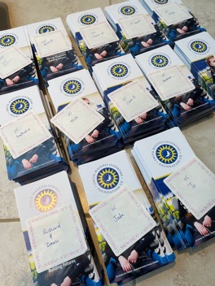
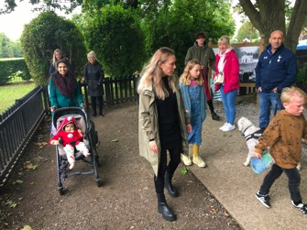
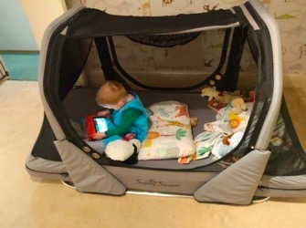
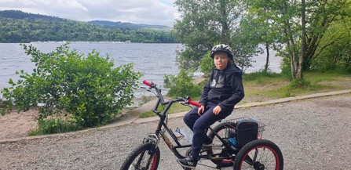
How do the SMS Foundation help?
Conferences
Emotional support
Fund research into SMS
Provide information
Promote and fund events and family get-togethers
Grants for equipment

Slide 6
Smith-Magenis Syndrome (SMS) explained through our logo

Slide 7
The SMS logo is made up of…
Sun
Moon
Stars

Slide 8
The sun and moon represent the body clock
With SMS the body clock is flipped!

Slide 9
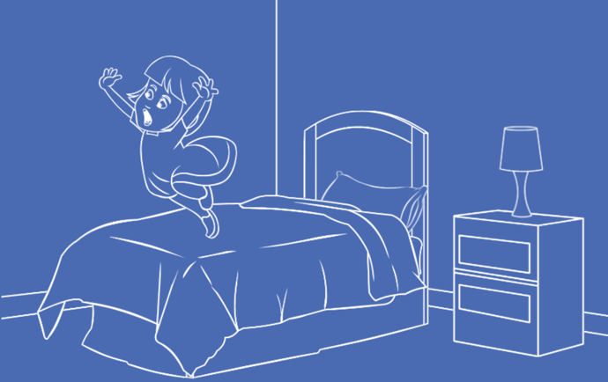
People with SMS are often awake through the night and sleepy during the day
Usually disrupting sleep for other family members!

Slide 10
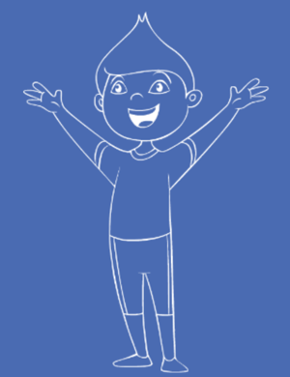
The jovial moon represents the pure, fun, and happy personality of people with SMS

Slide 11
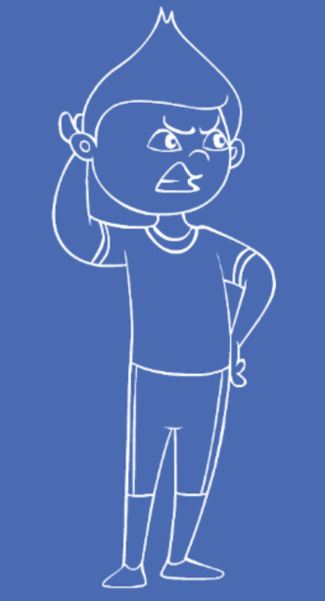
But there is also the dark and cold side of the moon…
This can mean some difficult behaviours like:
Self-injury
Aggression
Destruction
Meltdowns

Slide 12
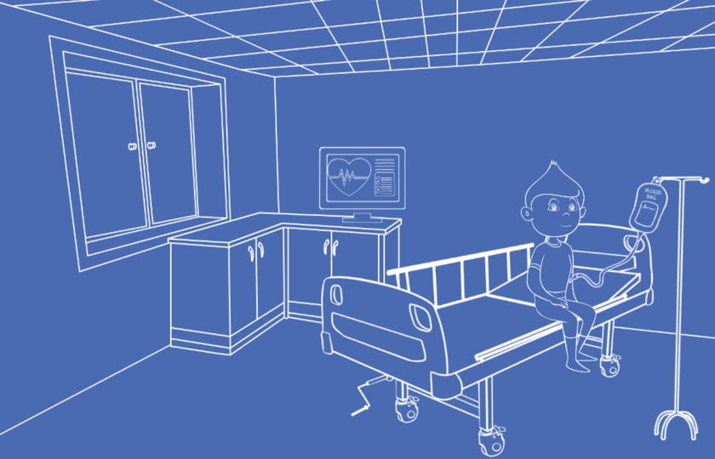
And many people with SMS face complex health challenges…

Slide 13
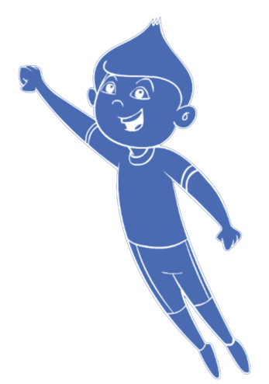
The warmth of the sun symbolises affection
People with SMS want to be the centre of our universe
like the sun is in the solar system

Slide 14
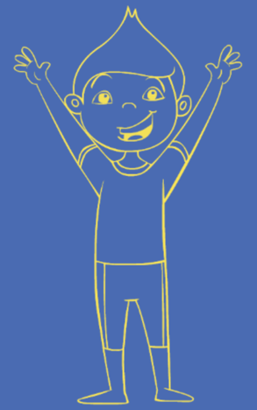
The sun is yellow, a colour that symbolises…
Joy
Happiness
Energy
People with SMS love to hug – they are known for it!
#SMSHugorbeHugged
Notes:
Has anyone heard of a syndrome before, or know someone who has a syndrome? Has anyone heard of Downs syndrome, or cystic fibrosis?
What are symptoms, does anyone know what they might be? How about hearing loss, feeling exhausted, physical differences in how we look?
A syndrome often describes a group of 1 or more different symptoms.

Slide 15
The sun has 17 points and there are 11 stars
Notes:
Has anyone heard of a syndrome before, or know someone who has a syndrome? Has anyone heard of Downs syndrome, or cystic fibrosis?
What are symptoms, does anyone know what they might be? How about hearing loss, feeling exhausted, physical differences in how we look?
A syndrome often describes a group of 1 or more different symptoms.

Slide 16
This represents a deletion or mutation on chromosome
17p11
It is also why we have our international awareness day on the 17th November (17/11)

Slide 17
The circle of stars represents our global SMS family
People with SMS shine brightly on their own and even brighter as a constellation

Slide 18
Blue is the colour of the sky, it symbolizes:
Trust
Loyalty
Confidence
Understanding
Stability

Slide 19
So, when you look up to the sky, or see our logo
Remember our story…

Slide 20
If there are clouds making it dark, never forget…
That the the sun, moon, and stars are only temporarily hidden and are waiting to re-emerge

